Slide 1
The Mathematics of Deep Learning
By
Ajit Jaokar

Slide 2
MLP and Convolution

Slide 3
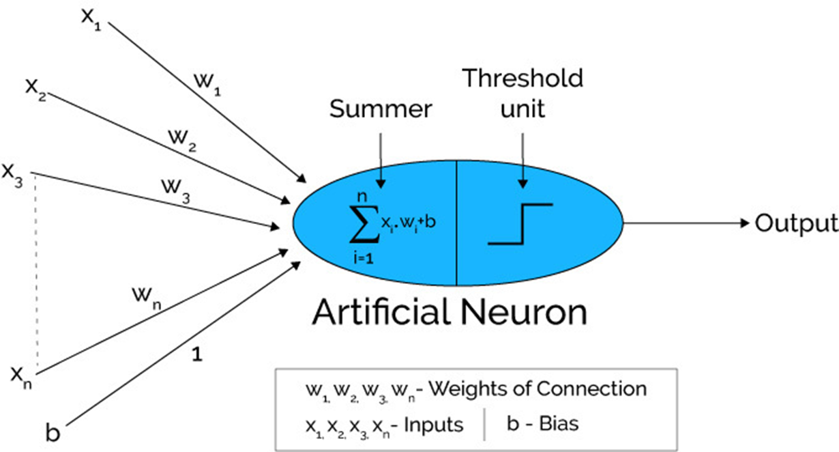
Image source: Xenon stack

Slide 4
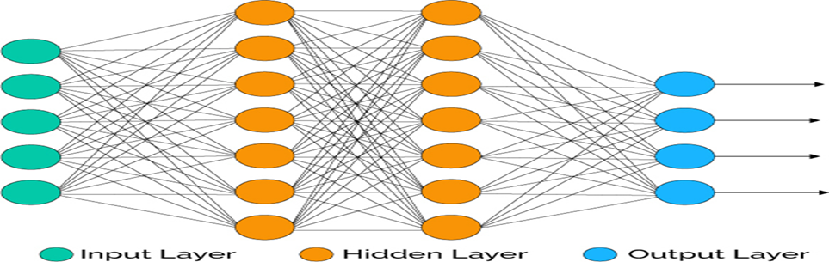
A Neural Network contains a large number of artificial neurons called units arranged in a series of layers. In typical Artificial Neural Network, comprises different layers:

Slide 5
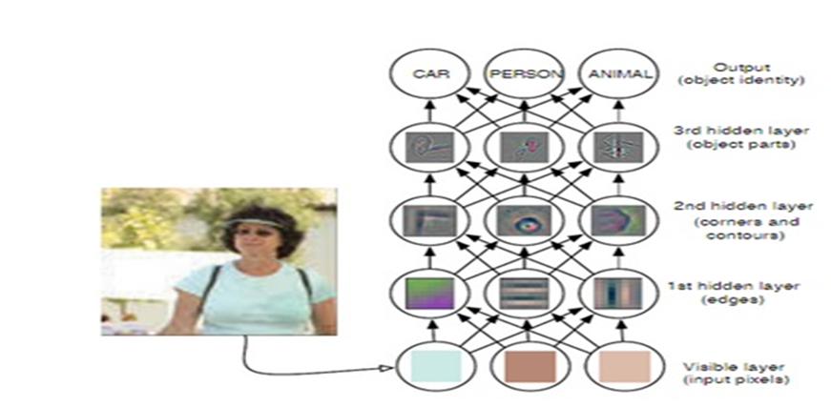
Image source

Slide 6
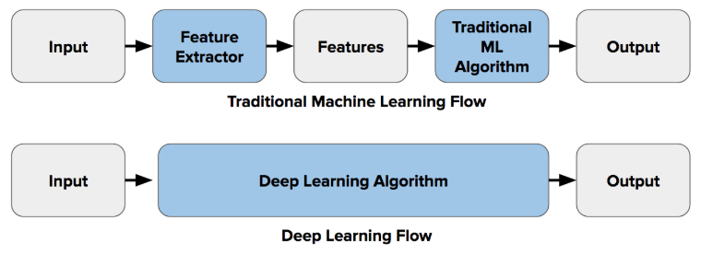
DL models use very large number of parameters and create complex and highly nonlinear representations.

Slide 7
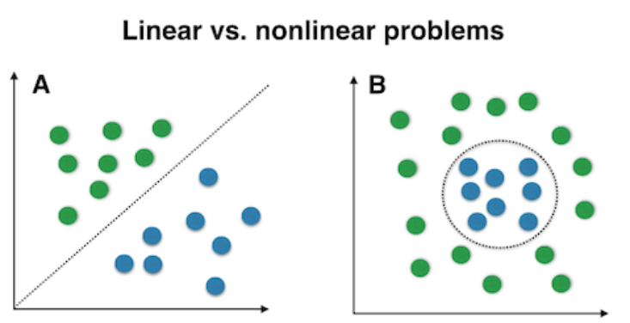
Deep learning models are inherently better to tackle such nonlinear classification tasks.

Slide 8
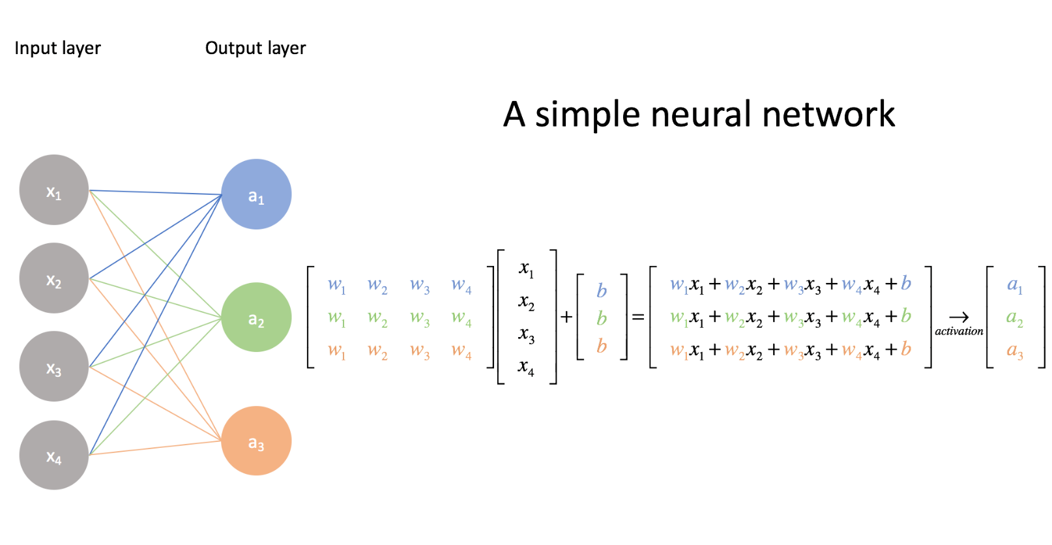
https://www.jeremyjordan.me/intro-to-neural-networks/

Slide 9
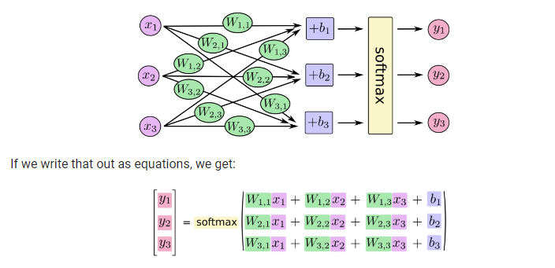
https://www.tensorflow.org/get_started/mnist/beginners

Slide 10
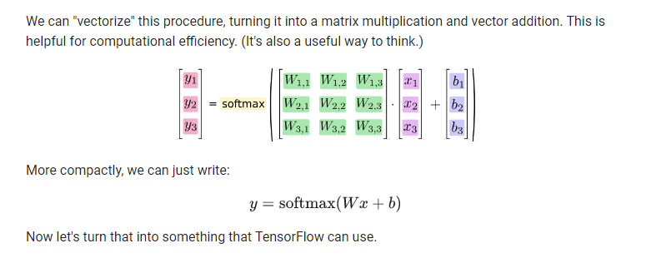
https://www.tensorflow.org/get_started/mnist/beginners

Slide 11
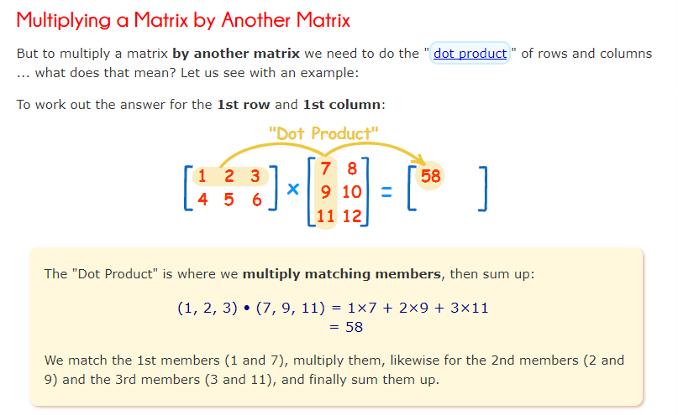
https://www.mathsisfun.com/algebra/matrix-multiplying.html

Slide 12
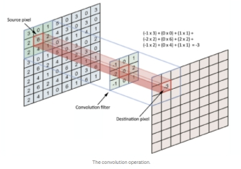

Slide 13
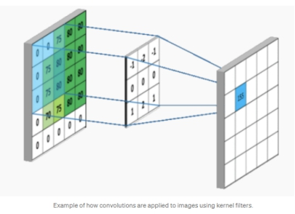

Slide 14
From a mathematical perspective, “Convolutional networks are simply neural networks that use convolution in place of general matrix multiplication in at least one of their layers." (reference Bengio – Goodfellow) i.e. instead of doing matrix-matrix multiplication between two layers, the convolution operation can be understood as a "kernel" or "filter" (a small matrix, e.g., 3x3) that slides over an input feature space (e.g., image, or the hidden layer units). Here, one sliding step does an element-wise multiplication between the "kernel" (e.g., 3x3) and an, e.g. 3x3 image patch resulting in an 3x3 output, which is summed up to a single number. This is repeated by sliding over the image then to obtain an output "image".

Slide 15
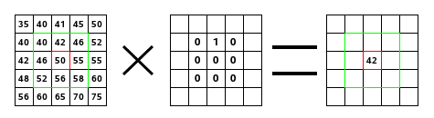
(40*0)+(42*1)+(46*0) + (46*0)+(50*0)+(55*0) + (52*0)+(56*0)+(58*0) = 42
https://docs.gimp.org/2.8/en/plug-in-convmatrix.html

Slide 16
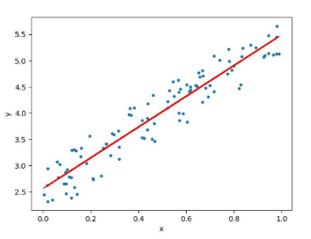
Equation of a straight line …

Slide 17
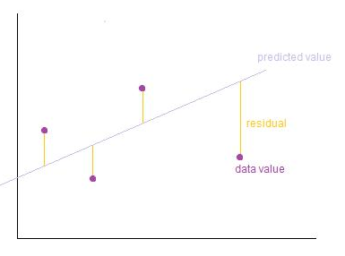
Image Credits: http://wiki.engageeducation.org.au/further-maths/data-analysis/resi...

Slide 18

To define and measure the error of our model we define the cost function as the sum of the squares of the residuals. The cost function is denoted by
Credits: http://www.wbur.org/radioboston/2013/09/18/bostons-housing-challenge
Multiple linear regression can be illustrated in the commonly used Boston Housing Dataset

Slide 19
One final aspect of the model we can infer is – MLP (Deep Learning) is an example of a highly parameterized model. Considering our example of finding the price of a house based on a set of features, for the equation y = mx + c, the quantities m and c are called the parameters. We derive the value of the parameters from the data and the strategy for solving the equation.

Slide 20
The parameters of an equation can be seen as the degrees of freedom. Linear regression has a relatively smaller number of parameters. However, the more complex MLP has a much wider range of parameters (degrees of freedom). Both are parameterized models, but MLPs follow a more complex optimization strategy (back propagation and gradient descent) than Linear Regression (least square)

Slide 21
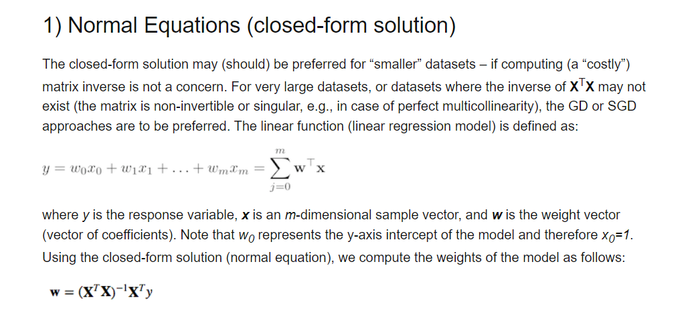
Image Credits: https://sebastianraschka.com/faq/docs/closed-form-vs-gd.html

Slide 22
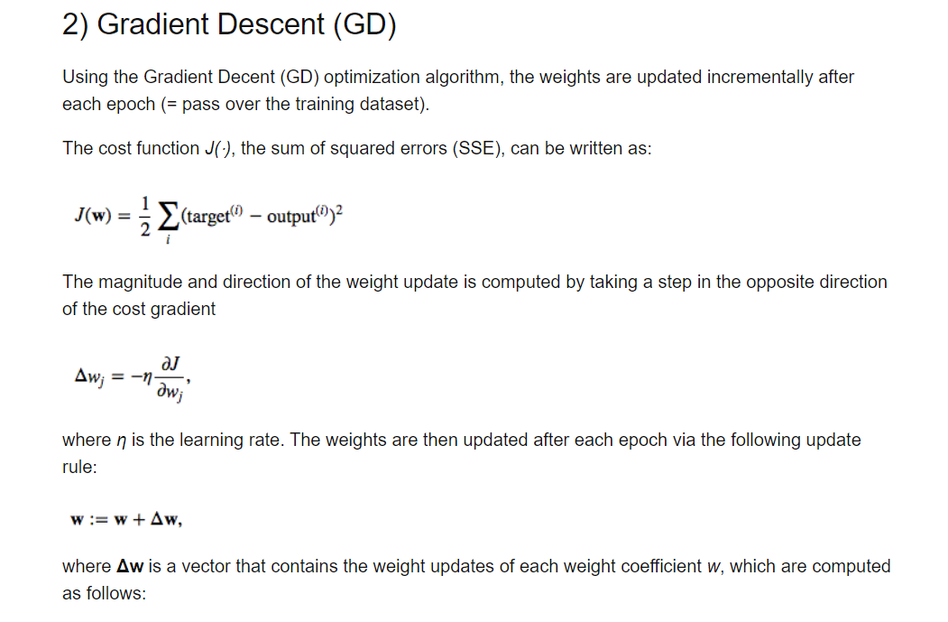
Image Credits: https://sebastianraschka.com/faq/docs/closed-form-vs-gd.html

Slide 23
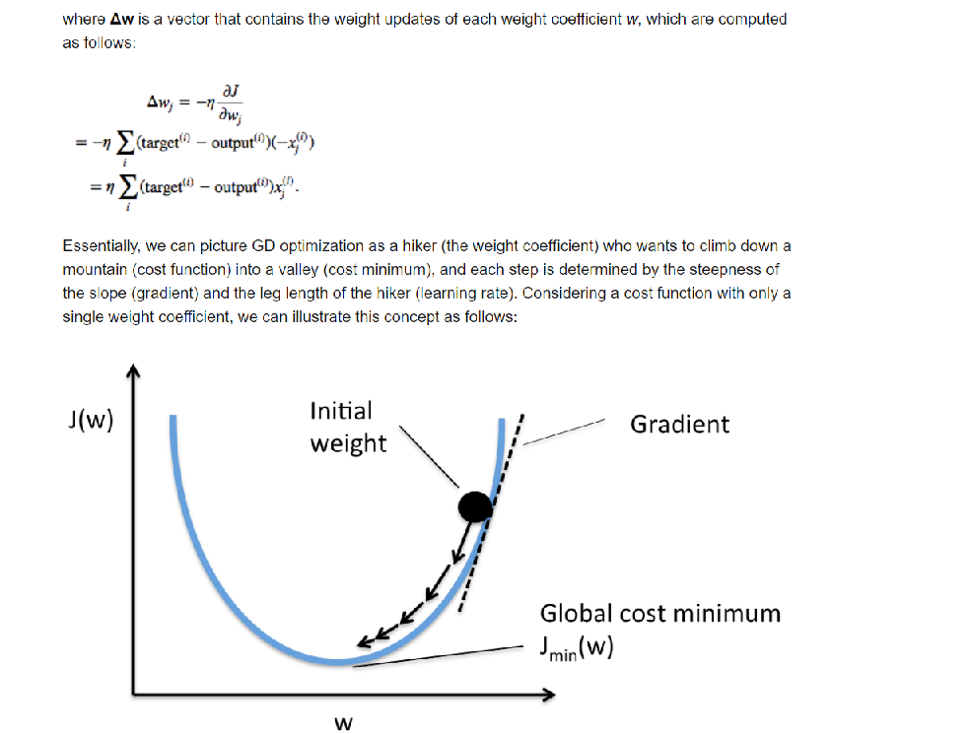
Image Credits: https://sebastianraschka.com/faq/docs/closed-form-vs-gd.html

Slide 24
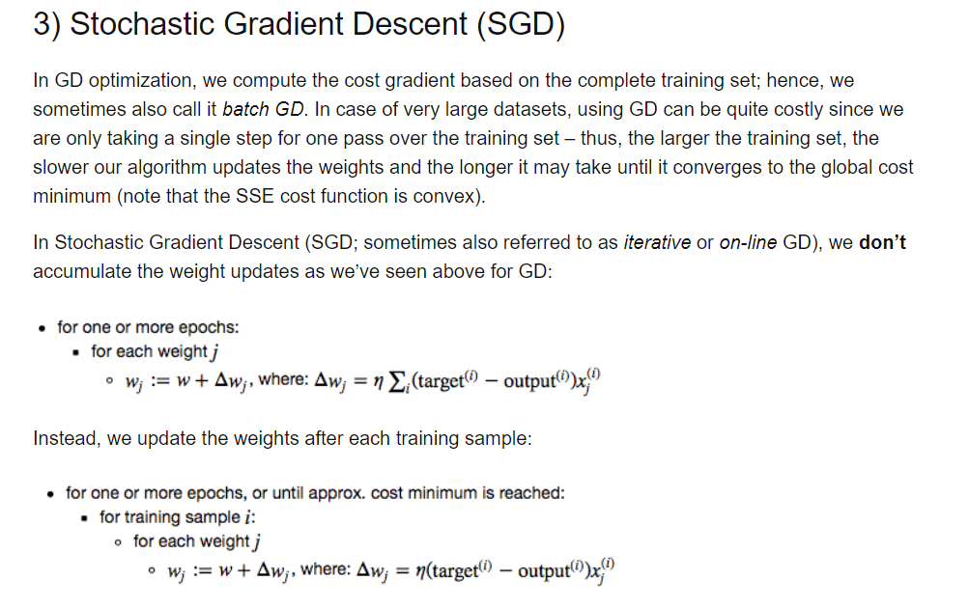
Image Credits: https://sebastianraschka.com/faq/docs/closed-form-vs-gd.html

Slide 25
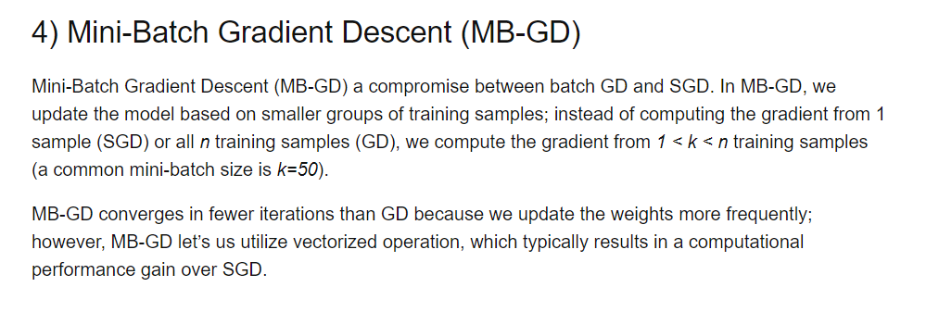
Image Credits: https://sebastianraschka.com/faq/docs/closed-form-vs-gd.html

Slide 26
Backpropagation and Gradient Descent

Slide 27
Back propagation: we find the total error and we apportion the error to each layer
For each neuron in the layer: Then apply gradient descent
Steps are
a) find total error
b) back propagate
c) apportion to each neuron
4) so at each neuron
Compute the gradients of J(total error) with respect to W(weights) and b(biases). Take a small step along the direction of the negative gradient
5) update can be stochastic, batch or minibatch (typically its minibatch)
https://towardsdatascience.com/batch-mini-batch-stochastic-gradient-descent-7a62ecba642a

Slide 28
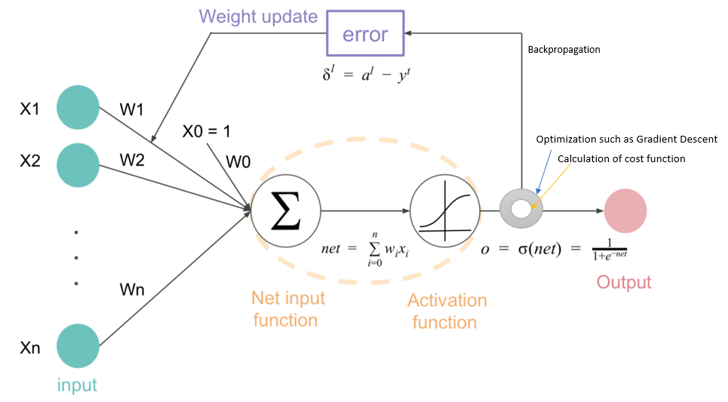
https://datascience.stackexchange.com/questions/44703/how-does-gradient-descent-and-backpropagation-work-together
Image Credits:

Slide 29
Understanding the significance of non-linearity
Before we proceed, we need to appreciate the significance of non-linearlity. Why do we need to use non-linear activation functions? What is the significance and benefit of non-linear functions? In a nutshell, without a non-linear activation function, the neural network is merely calculating linear combinations of values i.e. the network is combining the signals but is not creating a new signal / function.

Slide 30
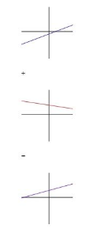
For example, the linear combination of two lines is another line. As we see below.

Slide 31
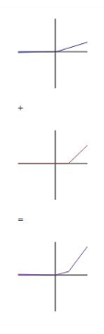
However, with a non-linear activation function like ReLU, the linear combination is a new type of function. We can construct entirely different (nonlinear) models in this way. So, introducing nonlinearity extends the kinds of functions that we can represent with our neural network.
Reference and image Quora Why does deep learning architectures only use the non-linear ...

Slide 32
Training a Neural Network
Training steps
The loss function is a performance metric which reflects how well the neural network generates values that are close to the desired values. The loss function is intuitively the difference between the desired output and the actual output. The goal of machine learning is to minimize the loss function. Hence, the problem of machine learning becomes a problem of minimizing the loss function.

Slide 33
A combination of Gradient descent and backpropagation algorithms are used to train a neural network i.e. to minimize the total loss function. The overall steps are
Forward propagate the data points through the network get the outputs
Use loss function to calculate the total error
Use backpropagation algorithm to calculate the gradient of the loss function with respect to each weight and bias i.e. apportion the error across the layers
Use Gradient descent to update the weights and biases at each layer
Repeat above steps to minimize the total error.

Slide 34
Hence, in a single sentence, we are essentially propagating the total error backward through the connections in the network layer by layer, calculate the contribution (gradient) of each weight and bias to the total error in every layer, then use gradient descent algorithm to optimize the weights and biases, and eventually minimize the total error of the neural network.
reference Ken Chen on LinkedIn

Slide 35
Explaining the forward pass and the backward pass
Forward Pass
Forward pass is basically a set of operations which transform network input into the output space. During the inference stage neural network (as opposed to the training phase), the network relies solely on the forward pass. Let’s consider a simple neural network with 2-hidden layers. Here we assume that each neuron, except the neurons in the last layers, uses ReLU activation function (the last layer uses softmax).

Slide 36
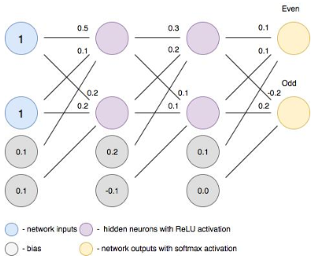

Slide 37
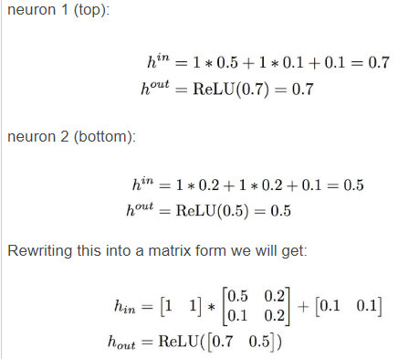

Slide 38
Backward Pass
In order to start calculating error gradients, first, we have to calculate the error (i.e. the overall loss). We can view the whole neural network as a composite function (a function comprising of other functions). Using the Chain Rule, we can find the derivative of a composite function. This gives us the individual gradients. In other words, we can use the Chain rule to apportion the total error to the various layers of the neural network. This represents the gradient that will be minimized using Gradient Descent.
Reference and image source: under the hood of neural networks part 1 fully connected

Slide 39
A recap of the Chain Rule and Partial Derivatives
We can thus see the process of training a neural network as a combination of Back propagation and Gradient descent. These two algorithms can be explained by understanding the Chain Rule and Partial Derivatives.

Slide 40

The Chain Rule
The chain rule is a formula for calculating the derivatives of composite functions. Composite functions are functions composed of functions inside other function(s). Given a composite function f(x) = h(g(x)), the derivative of f(x) is given by the chain rule as

Slide 41

You can also extend this idea to more than two functions. For example, for a function f(x) comprising of three functions A, B and C – we have
f(x) = A(B(C(x)))
The chain rule tells us that the derivative of this function equals:

Slide 42
Gradient Descent and Partial Derivatives
Gradient descent is an iterative optimization algorithm which is used to find the local minima or global minima of a function. The algorithm works using the following steps
We start from a point on the graph of a function
We find the direction from that point, in which the function decreases fastest
We travel (down along the path) indicated by this direction in a small step to arrive at a new point

Slide 43
The slope of a line at a specific point is represented by its derivative. However, since we are concerned with two or more variables (weights and biases), we need to consider the partial derivatives. Hence, a gradient is a vector that stores the partial derivatives of multivariable functions. It helps us calculate the slope at a specific point on a curve for functions with multiple independent variables.

Slide 44
We need to consider partial derivatives because for complex(multivariable) functions, we need to determine the impact of each individual variable on the overall derivative. Consider a function of two variables x and z. If we change x, but hold all other variables constant, we get one partial derivative. If we change z, but hold x constant, we get another partial derivative. The combination represents the full derivative of the multivariable function.
Thus, the entire neural network training can be seen as a combination of the chain rule and partial derivatives

Slide 45
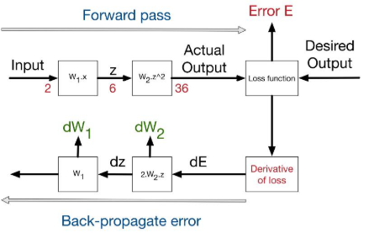
Reference and image source - neural networks and backpropagation explained in a simple way

Slide 46
Big Picture
To recap, considering the big picture - we have the starting point of errors, which is the loss function. This figure shows the process of backpropagating errors following this schemas:
Input -> Forward calls -> Loss function -> derivative -> backpropagation of errors. At each stage we get the deltas on the weights of this stage. For the figure below, W1 = 3 and w2 = 1

Slide 47
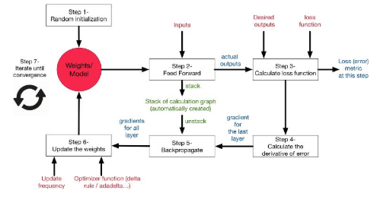
Reference and image source - neural networks and backpropagation explained in a simple way

Slide 48
To recap
Backpropagation is an efficient method of computing gradients.
Backpropagation is a simple implementation of chain rule of derivatives, which simply gives you the ability to compute all required partial derivatives
"trained with backprop", what actually means "trained with an optimization technique using backprop as a gradient computing technique".
Optimization techniques update the weights and they include variants of gradient descent like Batch, SGD, mini batch and also specific optimization techniques like Adam

Slide 49
Sources
https://datascience.stackexchange.com/questions/44703/how-does-gradient-descent-and-backpropagation-work-together https://www.quora.com/What-is-the-difference-between-backpropagation-and-gradient-descent-when-training-a-deep-learning-neural-network-Which-of-the-two-is-Tensorflow-using https://medium.com/datathings/neural-networks-and-backpropagation-explained-in-a-simple-way-f540a3611f5e https://ruder.io/optimizing-gradient-descent/ https://towardsdatascience.com/intuitively-understanding-variational-autoencoders-1bfe67eb5daf https://explained.ai/matrix-calculus/index.html

